Slide 1

Fitcoin
Midway Milestone Presentation

Slide 2

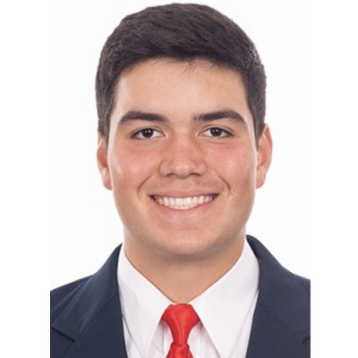
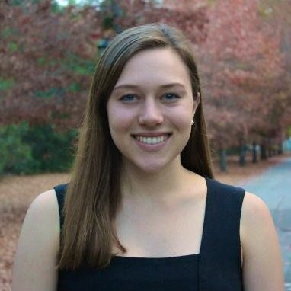
People
Nick M.
Developer/Designer
Dylan P.
Developer/Designer
Caroline F.
Product Manager

Slide 3
Value Proposition:
Fun Fitness for All!
Problem:
People can’t sustain their healthy exercise habits. Unmotivated by arbitrary health goals, people find exercise monotonous and chore-like.
Solution:
Our solution is to gamify fitness so it’s accessible and sustainable for all people by providing communities and fun activities.

Slide 4
Talk Overview
Heuristic Evaluation + Revised Design
Hi-Fi Prototype

Slide 5
Heuristic Evaluation and Revisions
Notes:
Worth pointing out that due to some overlapping HE results, some of the points in the slides below encompass one or more HE results. For example, there was several HE that comment on the zoomed in views, so these were placed into one to ensure the presentation fitted in 10 minutes

Slide 6
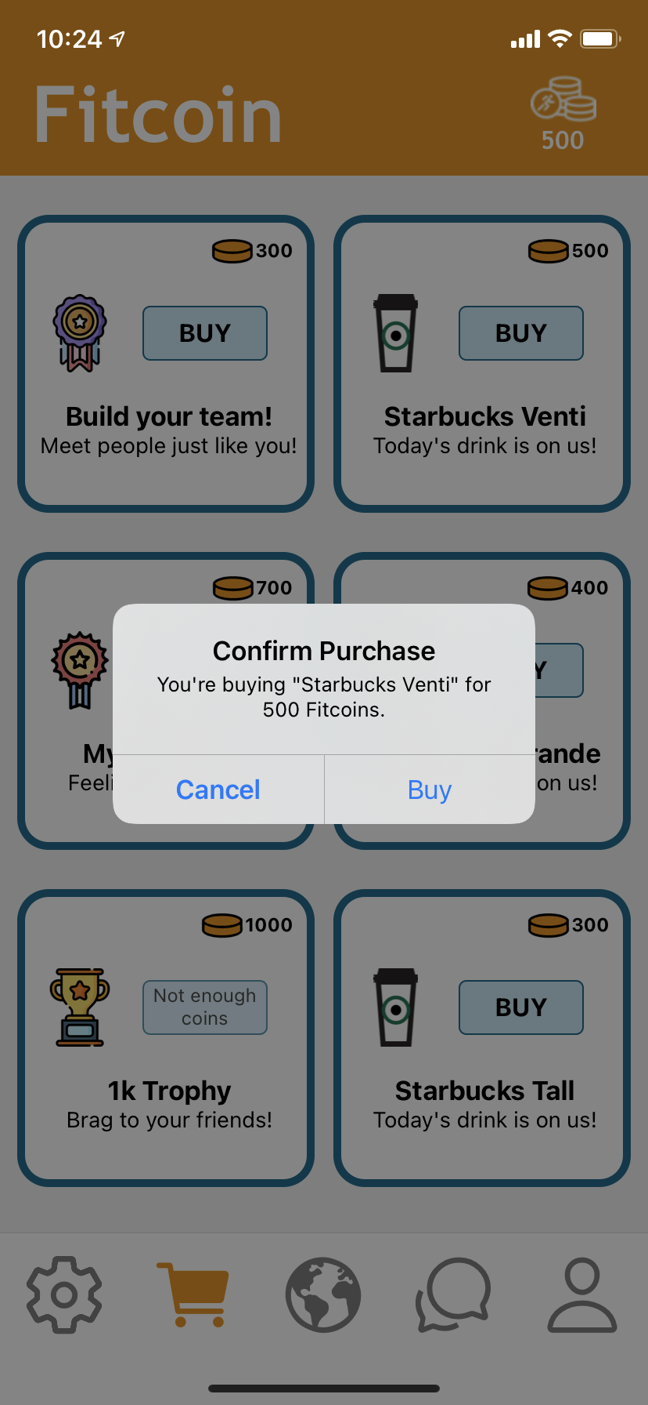
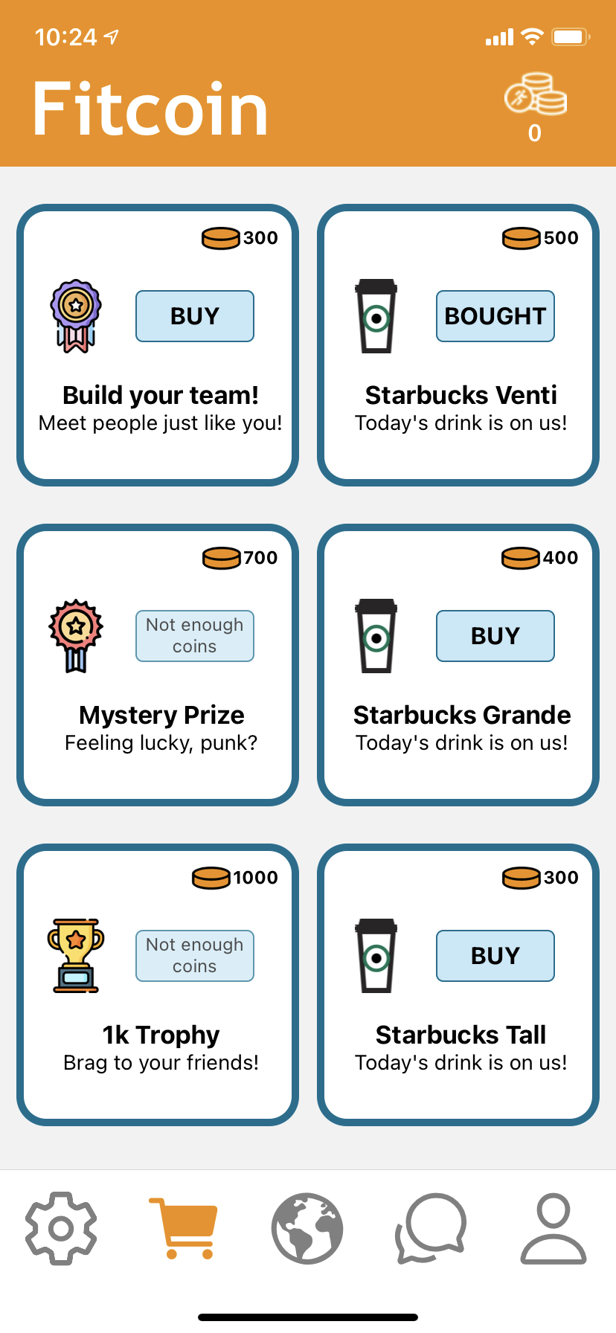
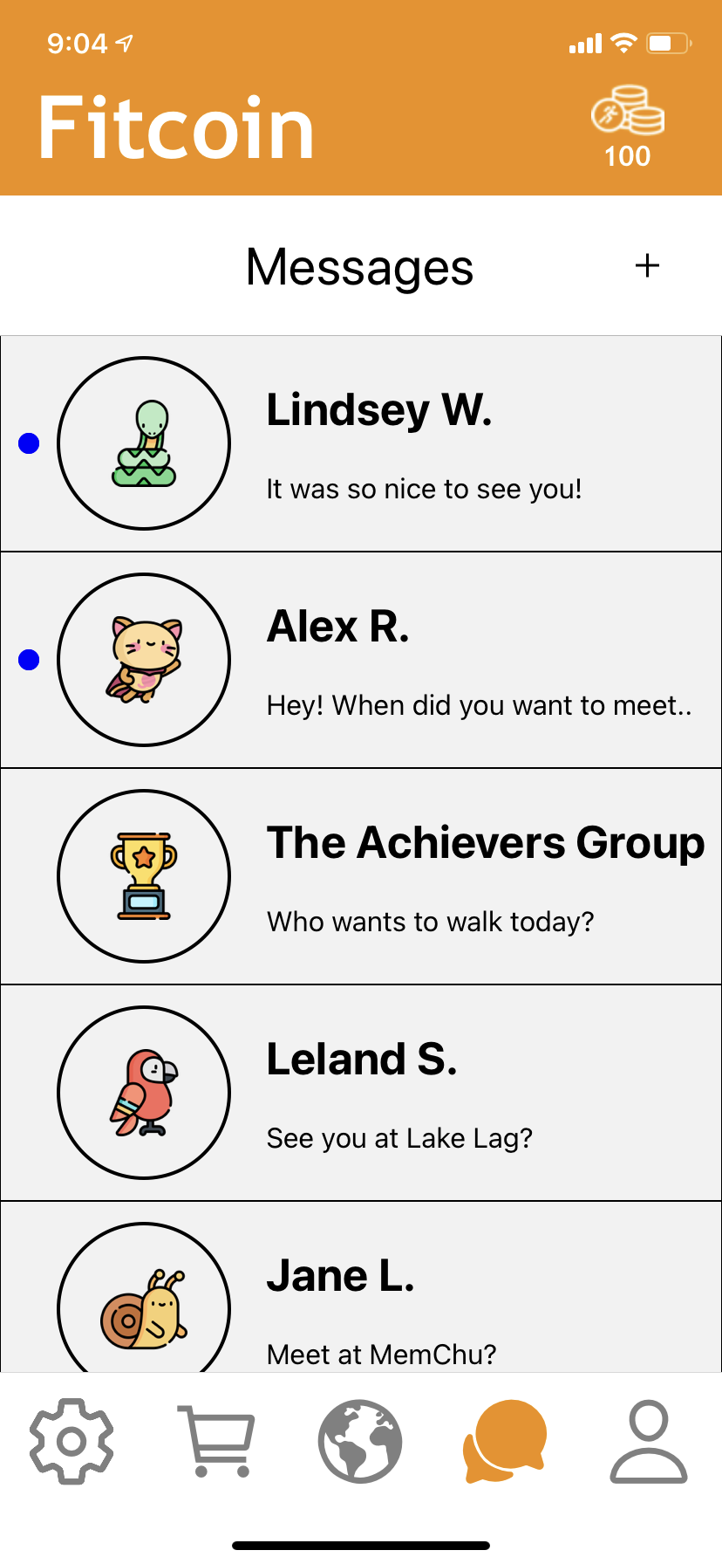
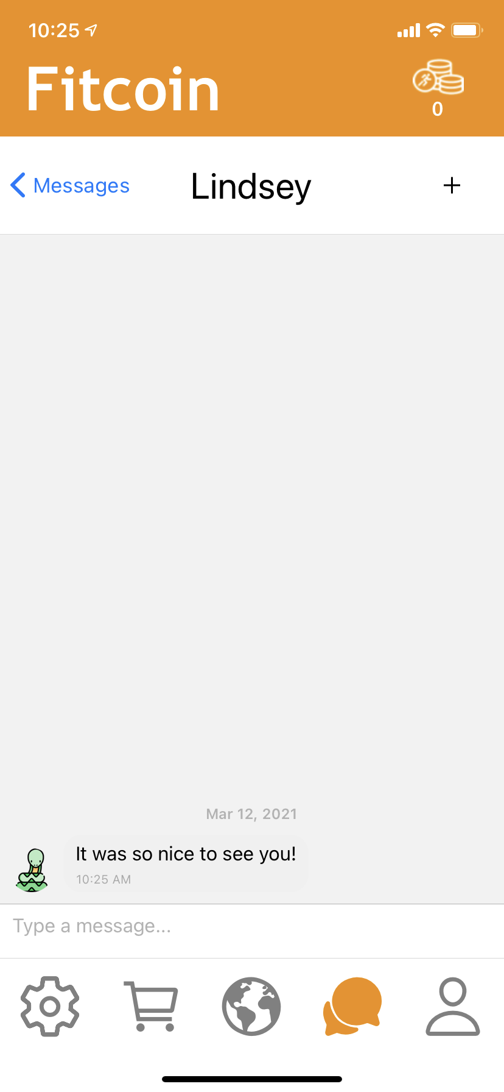
Major Revisions 1
Heuristic Evaluation Result
No confirmation of task completion
  On shop purchase (also optional back button)
  On reaching Fitcoin
  On sending message
Corresponding Design Revision Decision
1.1. Confirmation pop-up message implemented in shop that allows confirmation or cancellation of purchase
1.2 Messages implemented with Gifted Chat with hard-coded messages
1.3 Map in Progress - Will have interactive coin collection action

Slide 7
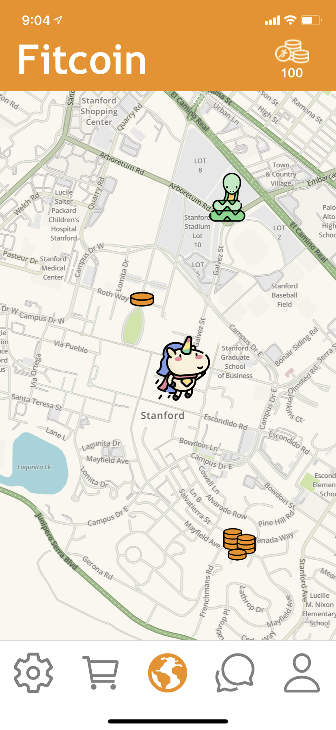
Major Revisions 2
Heuristic Evaluation Result
Detailed views on Map Screen can be cluttered and inconsistent
Design Revision Decision
1. Map in progress - Working through consistency solutions

Slide 8
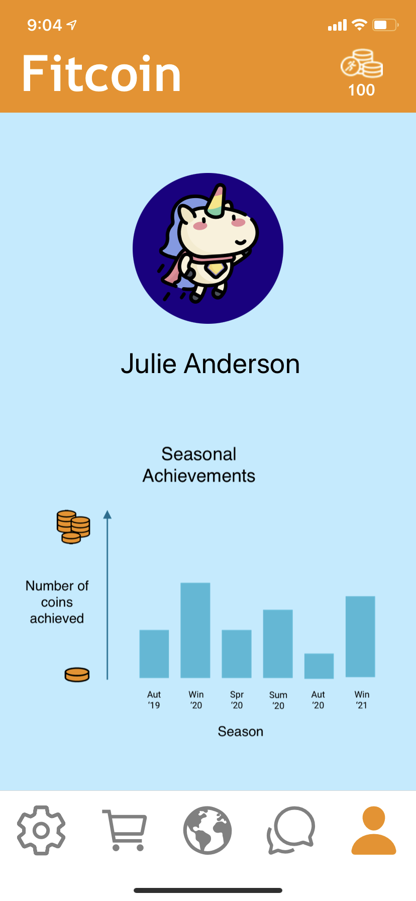
Minor Revisions 1
Heuristic Evaluation Result
No y-axis values on graph in profile screen
Progress word in Profile unclear
Design Revision Decision
Created meaningful y-axis
Update profile screen to increase clarity

Slide 9
Minor Revisions 2
Heuristic Evaluation Result
Back Button is unclear in Map screens
Shop screen has too many colours
Shop screen doesn’t indicate too expensive items.
Design Revision Decision
Map in Progress - Will change title/style of back button
Took out background colour of shop screen
Greyed out too expensive items

Slide 10
Minor Revisions 3
Heuristic Evaluation Result
Messages need timestamps
New Messages need to be indicated
Design Revision Decision
Gifted Chat system automatically adds timestamps
Blue dot for new messages - time permitting

Slide 11
Infeasible Revisions
Heuristic Evaluation Result
No onboarding
Reduce clutter on map screen by having a toggle between maps with fitcoins and/or friends with hotspots of local workout areas
Map coin stack amounts unclear and add a legend
Justification
Not essential to our tasks
  No usability data that onboarding was required to use
We really liked this idea. However,
  time frame limitations
  not core to our tasks
Edited coin stacks so now 3 types of coin stack images that map to 3 coin stack amounts, making a legend unnecessary in our opinion.

Slide 12
Hi-Fi Prototype Overview

Slide 13
Tools Used
React Native for designing
GitHub for collaboration

Slide 14

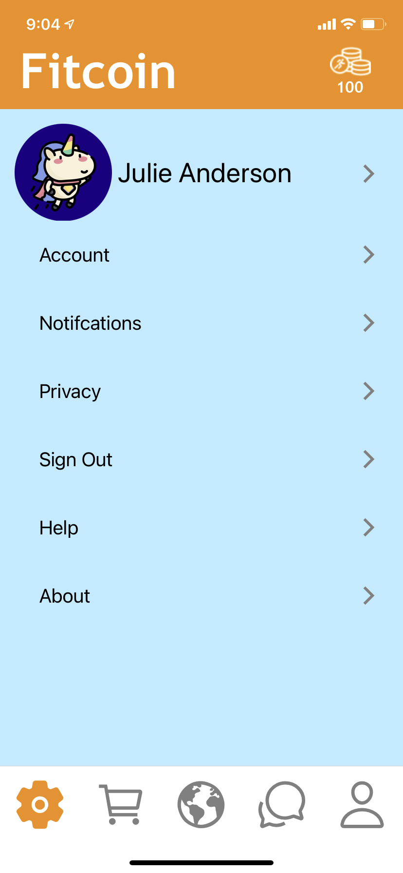
Implemented Features
Task 3
Task 2
Other 3 Screens

Slide 15
To Do
Map Screen
  Method of technical implementation decided
Polish

Slide 16
Wizard Of Oz + Hard-Coded Data
Map: Hard Coded Photo as Map. In Progress.
Settings and Profile: Hard Coded Sketch File as Page
Messages: Hard Coded Messages, and Wizard of Oz Gifted Chat System.

Slide 17
Live Demonstration and Summary

Slide 18
Questions?

Slide 19
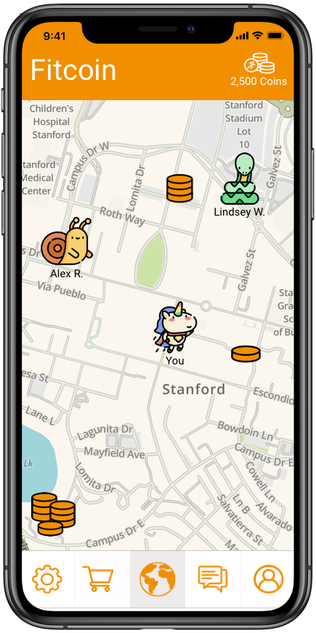
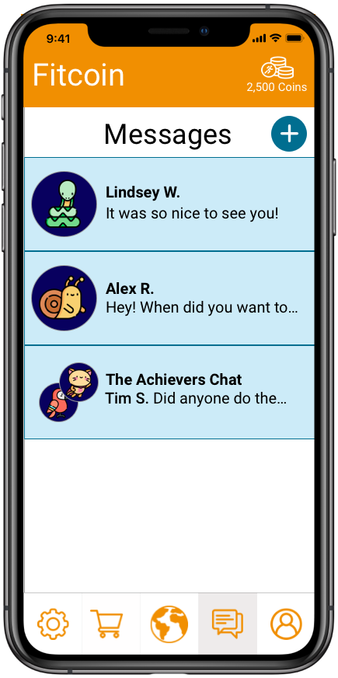
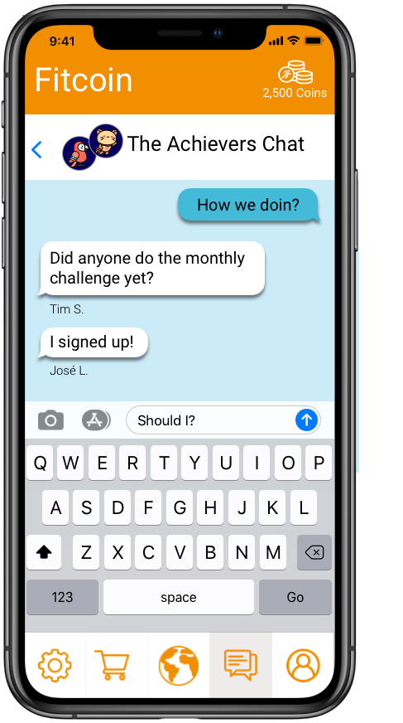
Wizard of Oz Techniques & Hardcoding
The only Wizard of Oz techniques we used involved hardcoding the Map/Location features and Messages.
Hardcoding: The user location and map were hardcoded to replicate our tracking functionality. Messages were hardcoded in to show design and function.

Slide 20
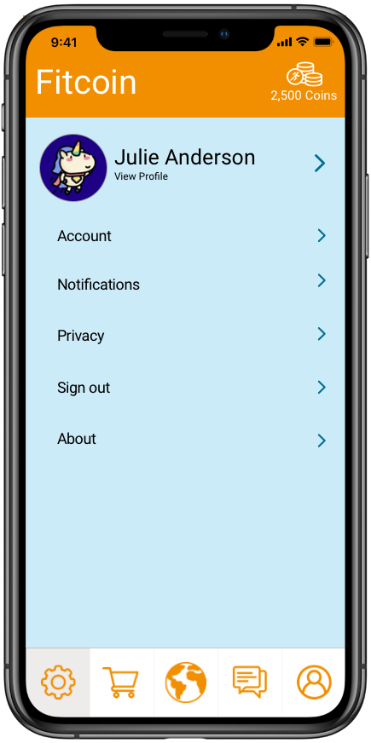
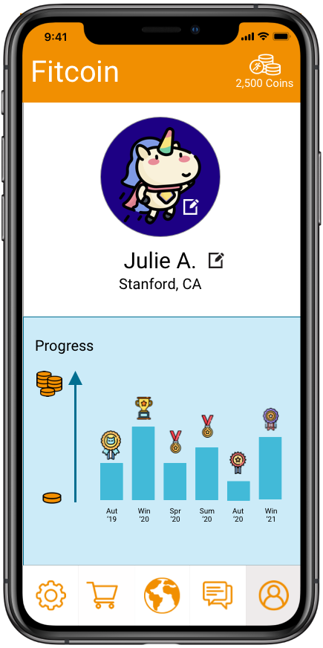
Appendix: Other Prototype Screenshots
Settings
Messages
Group Chat
Profile & Progress

Slide 21
Appendix
Medium-fi prototype link
Figma in application presentation mode: https://www.figma.com/proto/3clRPZwJQ9btxqjFdXxltL/Fitcoin%3A-Medium-Fi-Prototype?node-id=1%3A9&scaling=min-zoom
Figma in map mode: https://www.figma.com/file/3clRPZwJQ9btxqjFdXxltL/Fitcoin-Medium-Fi-Prototype?node-id=0%3A1

